Slide 1

Module 1:
Department of Mathematics Jain Global campus, Jakkasandra Post, Kanakapura Taluk, Ramanagara District -562112
Prof. Ramesha M
Department of Mathematics,
FET, Jain(Deemed-to-be-University)

Slide 2
Indeterminate forms and L'Hospital's rule.

Slide 3

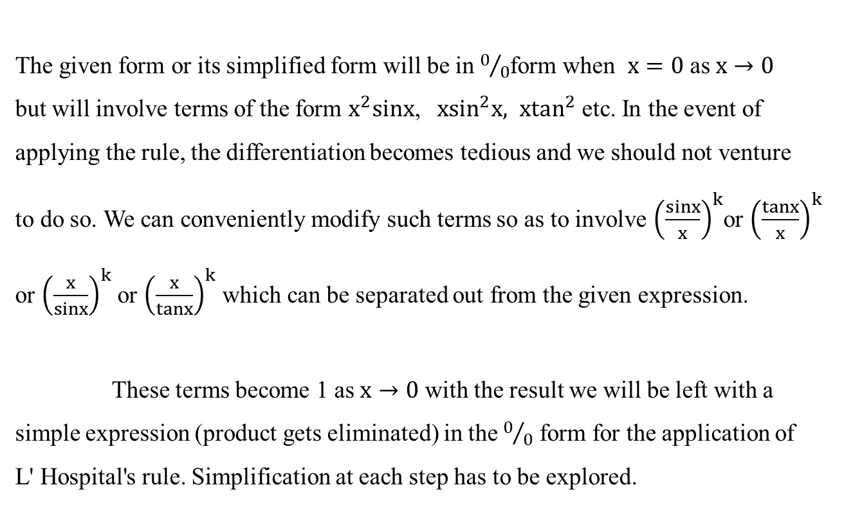
Indeterminate form ${(∞}/∞)$
The given form or its simplified form will be in $0/0$form when $x=0$ as $x→0$
but will involve terms of the form $x^{2}sinx$, ${ xsin}^{2}x, x\tan^{2}$ etc. In the event of
applying the rule, the differentiation becomes tedious and we should not venture
to do so. We can conveniently modify such terms so as to involve${\left(\frac{sinx}{x}\right)}^{k}$or ${\left(\frac{tanx}{x}\right)}^{k}$
or ${\left(\frac{x}{sinx}\right)}^{k}$ or ${\left(\frac{x}{tanx}\right)}^{k}$ which can be separated out from the given expression.
These terms become 1 as $x→0$with the result we will be left with a
simple expression (product gets eliminated) in the $0/0$form for the application of
L' Hospital's rule. Simplification at each step has to be explored.

Slide 4

Problems:
1. Evaluate
Solution:
y =
$$\left[\frac{∞}{∞} \text{form} \right]$$
On Applying L'Hospital's Rule, We get
Thus, = 0

Slide 5

2. Evaluate
Solution:
$$\left[\frac{∞}{∞} \text{form} \right]$$
On Applying L'Hospital's Rule, We get
Thus

Slide 6
3. Evaluate
Solution:
$$\left[\frac{∞}{∞} \text{form} \right]$$
On Applying L'Hospital's Rule, We get
On Applying L'Hospital's Rule, We get
Thus,

Slide 7






4. Evaluate
Solution:
$$\left[\frac{∞}{∞} \text{form} \right]$$
$$y=$$
On Applying L'Hospital's Rule, We get
On Applying L'Hospital's Rule, We get
$\text{Thus}\text{,} =1$

Slide 8
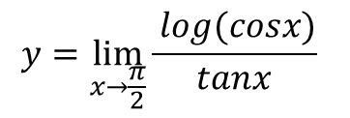
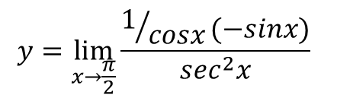
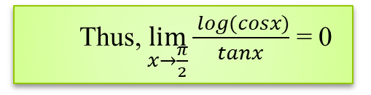

`5. Evaluate
Solution:
$$y=\lim_{x→\frac{π}{2}}{\frac{ log(cosx)}{tanx}}$$
$$\left[\frac{∞}{∞} \text{form} \right]$$
On Applying L'Hospital's Rule, We get
$$y=\lim_{x→\frac{π}{2}}{\frac{1/{cosx}(−sinx)}{\sec^{2}x}}$$
$$y=0$$
Thus, $\lim_{x→\frac{π}{2}}{\frac{ log(cosx)}{tanx}}$ = 0

Slide 9
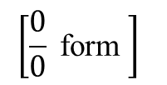


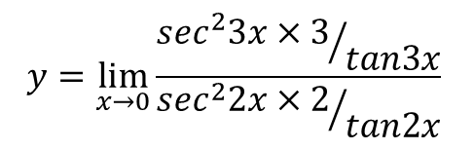
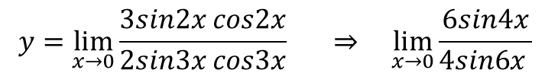
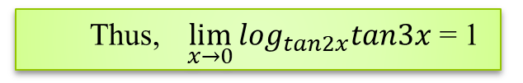
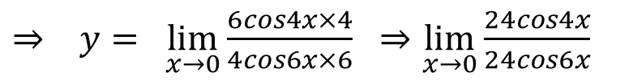
`6. Evaluate
Solution:
$$y=$$
On Applying L'Hospital's Rule, We get
$$y=\lim_{x→0}{\frac{{\sec^{2}3x×3}/{tan3x}}{{\sec^{2}2x×2}/{tan2x}}}$$
$$y=\lim_{x→0}{\frac{3sin2x cos2x}{2sin3x cos3x}} ⇒ \lim_{x→0}{\frac{6sin4x}{4sin6x }}$$
$$\left[\frac{0}{0} \text{form} \right]$$
On Applying L'Hospital's Rule, We get
$⇒ y= \lim_{x→0}{\frac{6cos4x×4}{4cos6x×6}}$$⇒$$\lim_{x→0}{\frac{24cos4x}{24cos6x}}$
$$y=1$$
Thus, $\lim_{x→0}{\log_{tan2x}tan3x}$ = 1

Slide 10
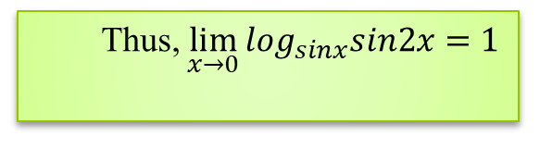


7. Evaluate $\lim_{x→0}{\log_{sinx}sin2x}$
Solution:
$$\left[\frac{∞}{∞} \text{form} \right]$$
On Applying L'Hospital's Rule, We get
On Applying L'Hospital's Rule, We get
Thus, $\lim_{x→0}{\log_{sinx}sin2x}=1$

Slide 11
Thank You

